Slide 1
Python! Day 16
Learn about files and file paths
Add a high score to the snake game
Mail merge project

Slide 2
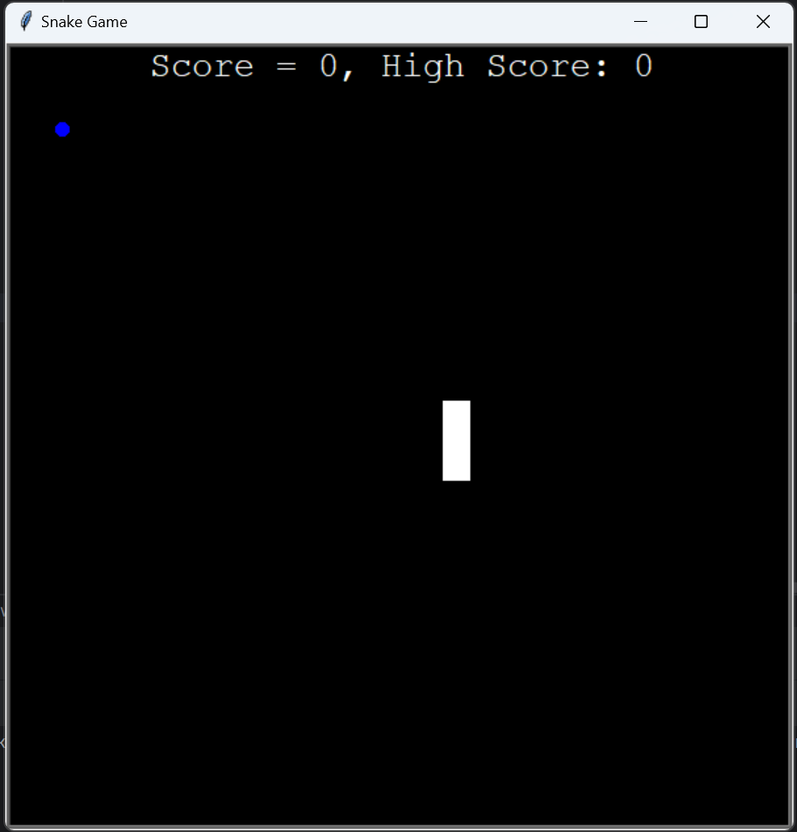
Adding a High Score to the Snake Game
Let’s improve the snake game by making the scoreboard also display the high score instead of just the current score
To start, we can create a high score variable in our scoreboard class and make the scoreboard write:
“Score = “ + str(score) + “, High Score = “ + str(high_score)
In our game_over function, we can update the high score by checking if the current score is bigger than the current high score:
if score > high_score:
high_score = score

Slide 3
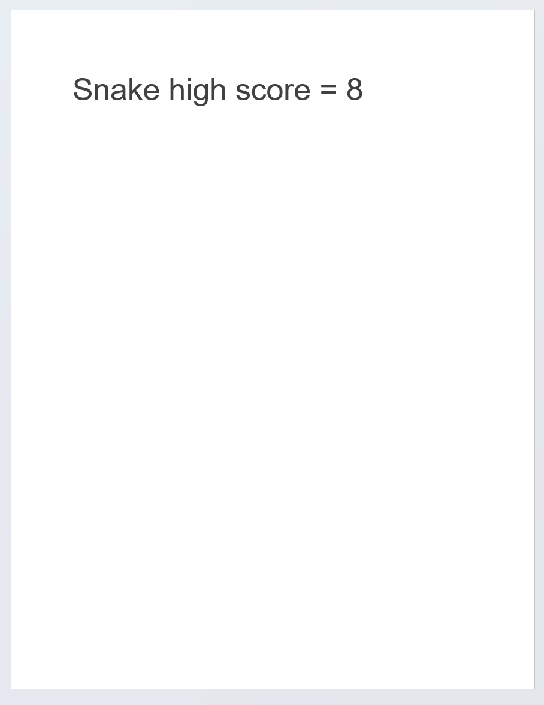
Tracking the High Score
Now, our main issue is figuring out how exactly to track the high score
If we run our code now, the high score won’t change in the next game because the high score variable is reset to 0 whenever the code runs from the beginning
To solve this problem, let’s try and think about what we’d do if we want to track our high scores when not using python
We might want to write it down on a Word document or a piece of paper
To keep track of the high score, we’re going to try to do the same thing using Python

Slide 4

Files
To eventually track our snake game’s high score, we’re going to need to learn how to manipulate files
To start, let’s create a new Python project and call it something like “File Project”
We should also create our main.py file inside the new project
Next, let’s create a text file that we’ll access and change through our main.py file
To do this, right-click your project folder and create a new file called “my_file.txt”

Slide 5
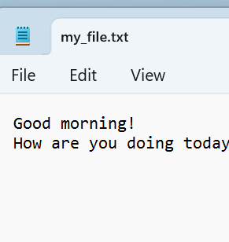
Opening and Reading a Text File
Let’s write something in our text file. What you write doesn’t really matter right now, so we can write something random, like what we plan to eat for dinner
Next, let’s open this text file in our main.py program and print its contents
file = open(“my_file.txt”)
contents = file.read()
print(contents)
file.close()

Slide 6

Why Close Files?
The file.close() line at the end of our code may seem unnecessary, but we should always close our files when we’re done with them
This is because leaving the files open takes up processing power on your computer
It’s kind of like keeping a tab open on your computer. If you have too many tabs or files open, your computer will start to have problems

Slide 7

The with Keyword
Another way we can write our main.py code is like this:
with open(“my_file.txt”) as file:
contents = file.read()
print(contents)
This uses the with keyword to organize our code
This is useful because it automatically closes our file when we’re done with the code inside “with open(“my_file.txt”) as file,” so we don’t have to remember to write file.close() at the end of our program

Slide 8
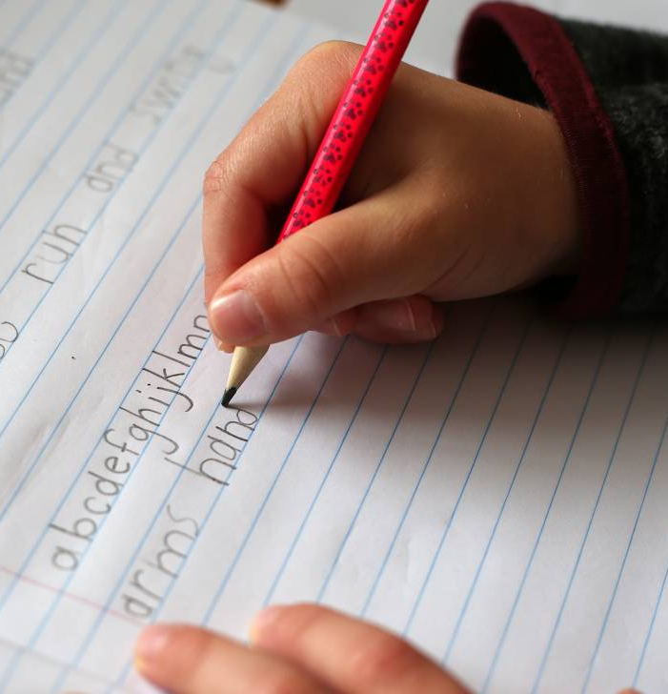
Writing in a Text File with Python
We can replace the text in a text file by writing this:
with open(“my_file.txt”, “w”) as file:
file.write(“New text”)
Notice how we had to add a “w” input to the open method. This changes the file mode from read-only (default) to write
If we forget the “w”, we get an error because we’re trying to write in a read-only file
Now, if we go to our text file, all of our previous text will have been replaced by “New text”

Slide 9

If we just want to add text to our file instead of replacing all the text, we can change the file mode to “a” for append
with open(“my_file.txt”, “a”) as file:
file.write(“New text”)
Note that if you are in the write mode (“w”) and try to open a file that doesn’t exist, instead of getting an error like normal, Python will create a new file for your
For example, this will create a new text file called “new_file.txt”:
with open(“new_file.txt”, “w”) as file:
file.write(“New text”)

Slide 10
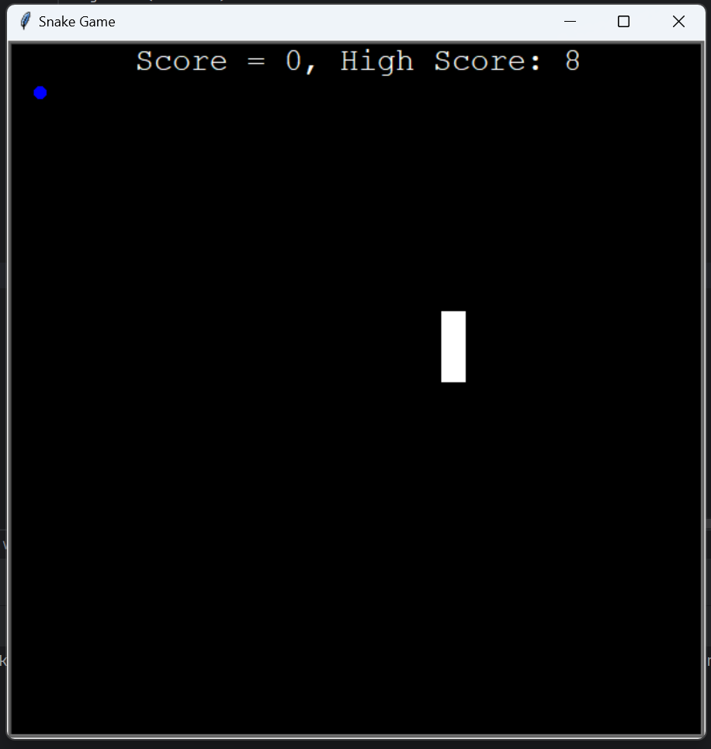
Using Files to Track the Snake Game High Score
To start, let’s create a new file in our snake game program called “data.txt,” and the only thing that we’ll write in this new file is the number 0
Next, we’ll want to open and read our text file in our __init__ method so we can set self.high_score equal to the number in data.txt
with open(“data.txt”) as data:
recorded_high_score = int(data.read())
self.high_score = recorded_high_score

Slide 11
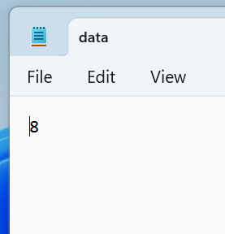
Next, we’ll want to go to our game_over method and write the new high score in our data.txt file when the game is over
with open(“data.txt”, “w”) as data:
data.write(str(self.high_score))
Now, our high score should update after each game

Slide 12
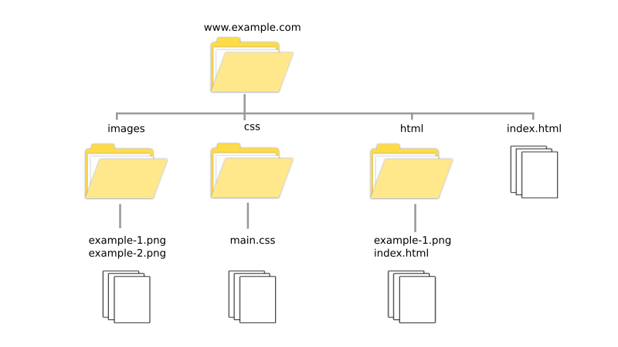
File Paths
So far, we’ve only been accessing files that are in the same place as our main.py file, but what if we want to access a file elsewhere on your computer?
If this case, we’d use a file path to tell Python where we want it to look for the file
There are two types of file paths: absolute file paths and relative file paths
Absolute file paths start from the “root” of your computer
Relative file paths start from the place where the python file is in

Slide 13
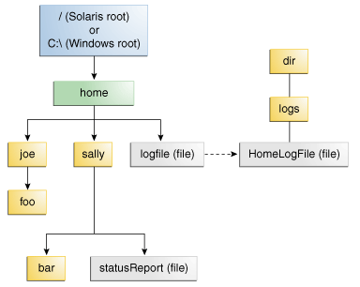
Absolute File Paths
Absolute file paths start from the root of a computer (Macintosh HD for a Mac, C: Drive for a Windows computer) and then travel through all of the folders necessary to get to a file
To find the absolute file path on a Mac:
Right-click the file > Get Info > General: > Where:
To find the absolute file path on a Windows Computer:
Right-click the file > Properties > Location:
To use this in Python, we write “/” to represent the root, then the file path separated by slashes, ending with the name of the file

Slide 14
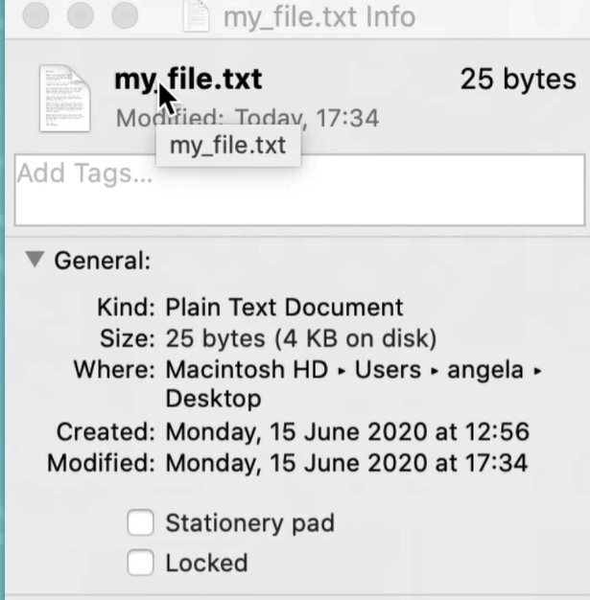
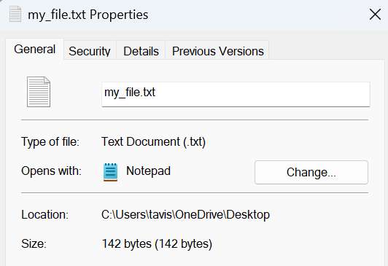
To open this file in Python using its absolute file path, we can write:
file = open(“/Users/angela/Desktop/my_file.txt”)
To open this file in Python using its absolute file path, we can write:
file = open(“/Users/tavis/OneDrive/Desktop/my_file.txt”)

Slide 15
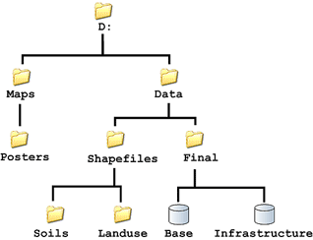
Relative File Paths
Relative file paths start in the folder the Python file is in and then can travel through folders to get to the correct location
For example, let’s say my main.py folder is in a folder called “File Project” and in that folder, in the same location as the main.py file, is another folder called “Text Files.” We want to access the text file in that folder.
Then, we could write:
file = open(“./Text Files/my_file.txt”)
The “./” indicates that we’re starting from the location the main.py program is in

Slide 16
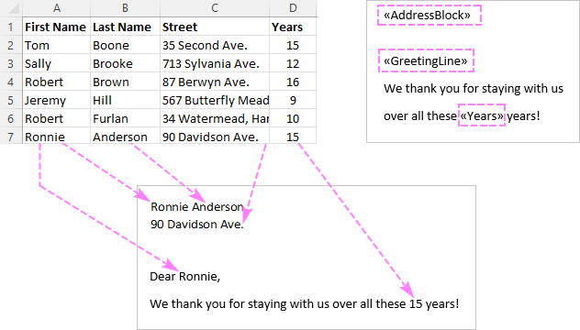
Project: Mail Merge Program
Companies and similar things often like to send out a whole bunch of emails to their customers with the customer’s name at the beginning of each email
To do this, companies use a mail merge program which uses a list of names and an email template to create emails with each person’s name on it
Let’s use files to create our own mail merge program

Slide 17
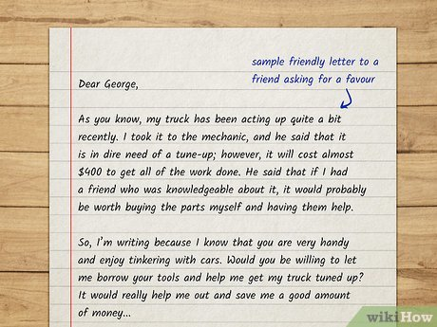
Mail Merge Program: Setup
Let’s set up our mail merge program by creating a list of names in a “names.txt” file
Let’s also write a “letter_template.txt” file where we write the letter we’ll be sending using “[name]” as a placeholder for each person’s name
Next, let’s create a folder inside our project called “Letters to Send”, this will hold all our finished letters

Slide 18
Mail Merge Program: Creating a List of Names
Next, let’s use our names.txt file to create a list of names in our main.py file
We’ll need to use the file.readlines() method to get a list of the contents of each line in the file
We’ll also have to use the string.strip(“\n”) method to get rid of all the \n characters
names = []
with open("names.txt", "r") as name_file:
names_unedited = name_file.readlines()
for n in names_unedited:
new_name = n.strip("\n")
names.append(new_name)

Slide 19
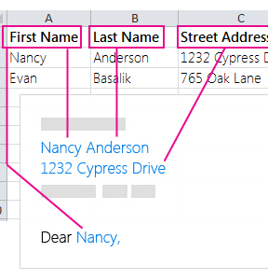
Mail Merge Program: Replacing [name]
Next, we’ll want to use a for each loop to create each individual letter
In the for each loop, let’s start by getting the contents of the letter template file
Next, we can replace [name] with the person’s name using the string.replace(old, new) method
for name in names:
text = ""
with open("letter_template.txt", "r") as letter_template:
letter_text = letter_template.read()
text = letter_text.replace("[name]", name)

Slide 20
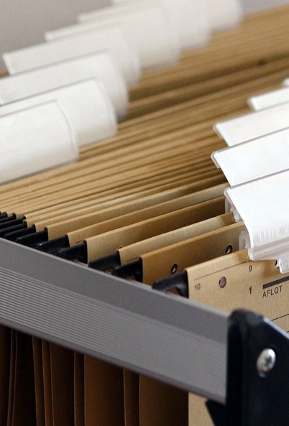
Mail Merge Program: Creating the File Name
Next, we should create the name and location of the new file
The file path will start with “./Letter to Send/” because we want these new letters to be in the Letters to Send folder
Then, we can add “letter_for” + name + “.txt” to create the actual file name
file_name = ".\Letters To Send\letter_for_" + name + ".txt"

Slide 21

Mail Merge Program: Writing the New Letters
Finally, we’ll want to use our new file name, file text, and the “w” file mode to create a new file for each letter
with open(file_name, "w") as letter:
letter.write(text)
Now, once we run our program, we should create a whole bunch of personalized letters in our Letters to Send folder

